Slide 1

ICT SERVICES NUTECH

Slide 2
ICT Services
LMS - Learning Management System
CMS - Campus Management System
NUET - Computer-based Entry Test
NUTECH Admission System
PERN - Pakistan Educational Research Network Services
Microsoft Teams
G Suite
Website
HEC Digital Library
ICT Policies for Online Services
NUTECH Wi-Fi Service
Digital Signage
Public Addressing System
Smart Classrooms
CCTV Cameras

Slide 3








ICT Services for Academia
LMS
PERN SERVICES
MS TEAMS
DIGITAL LIBRARY (LOCAL AND HEC)

Slide 4
Learning Management System
LMS provides the backbone for online education and is tailored as per university requirements
Deployed in NUTECH data center without any service disruptions to date
577 core courses, 1056 users created since deployment
Main features of LMS includes but not limited to the following:
  Home page slider
  Secure user authentication and mass enrolment
  Site announcements
  Course management (Assignment, quizzes, lectures)

Slide 5
LMS Features
Services Availability
Security
Data Backup
Additional Features

Slide 6
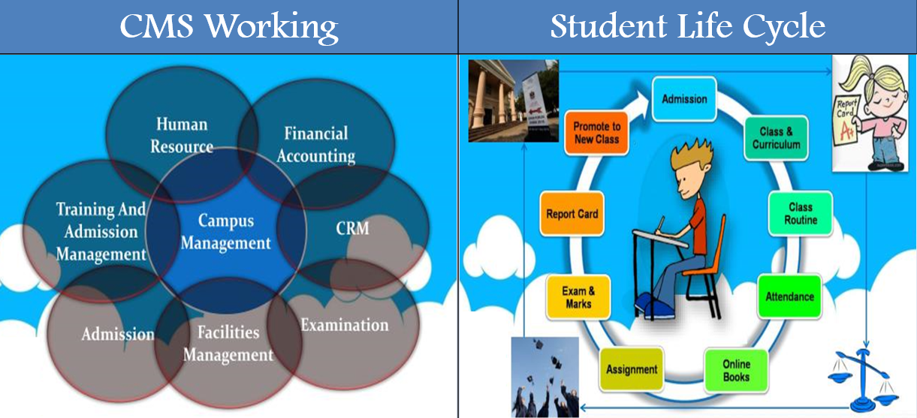
CMS
Provides backbone for
  Student Profile
  Course Enrollment
  Attendance
  Timetable Result notify
  Feedback survey
  Student Request(transcript, degree and term defer)
  Students Notification (Date sheet, holidays)
Open-source Odoo tailored as per NUTECH requirements

Slide 7

NUET(NUTECH entry test)
  Online Entry test for new candidates
  NUTECH has data bank of 30,000 MCQ’s
  Data bank created by highly qualified faculty
  Secure
  Student can improve test score by taking 3 Entry test per year
  Open-source Odoo tailored as per NUTECH requirements

Slide 8

NUTECH Admission System
  An online admission module has been implemented to allow students apply online through web portal.
  A structured and user-friendly system has been designed which simplify enrolment process

Slide 9
Features
  Student portal
  User friendly interface and admission processing
  Application submission
  Voucher generation
  Uploading academic documents and fee vouchers
  Slot booking for entry test and downloading admit card
  Entry test result checking
  Status checking in merit list

Slide 10
PERN SERVICES
Services designed especially for students to help and support them throughout the academic studies
Internet Bandwidth
HEC Digital Library
Video Conferencing
Turnitin Software
Network Consultancy
Technical Support

Slide 11
MS TEAMS
Unified communication and collaboration platform that combines persistent workplace chat, video meetings, file storage and application integration
Collaborative Classrooms
Professional Learning Community
Cloud Recording
Managing Academic Activities
On-Demand Webinars
Facilitate Distance Learning

Slide 12

G SUITE
G suite tools for effective online education
Services include:
      Google Assignment
      Google Calendar
      Google Classroom
  Google Drive
  Gmail, Google Chat
  Google Chrome
  Google Meet
Total number of accounts are 1897

Slide 13
Website https://nutech.edu.pk/
NUTECH website is a gateway to provide valuable information/ services to students, faculty and other visitors
Mobile compatible, well-planned information architecture, well-formatted content, responsive, secure & scalable
Enhances the accessibility in terms of quality, range and services
Enables visitors to explore the related information and provides an ease to retrieve data

Slide 14
Resources & Information
Departments details
Faculty Profiles
Access to Digital Library, NIMS & LMS
Important announcements including date sheets academic policies, scholarships etc
News & Events
Job opportunities and tenders
Course curriculum & outlines
Faculty/ employees profiles
Admission Announcement

Slide 15
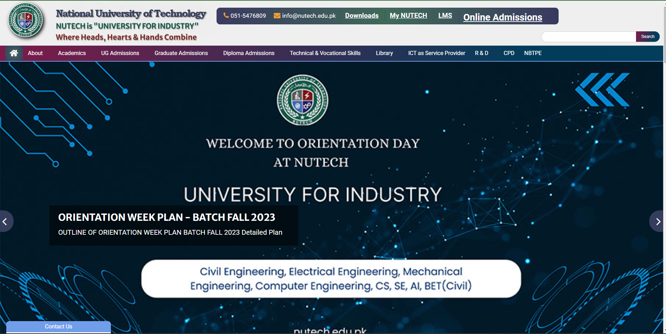

Slide 16


HEC Digital Library
Empower university students with swift access to extensive academic resources, optimizing their research and learning efficiency
Ensure 24/7 availability, accommodating students' diverse schedules and enhancing resource accessibility
Additionally, digital libraries encourage collaborative learning and knowledge sharing, cultivating a dynamic academic community.

Slide 17

ICT Policies for Online Services
VPN Policy
Email Retention Policy
Internet Use Policy
Web Application Security Policy
Password Policy
Authorized Internet Through LAN Access Policy
Internet Bandwidth Policy
HEC Services – Turnitin Policy
Authorized Internet Wi-Fi Access

Slide 18

NUTECH Wi-Fi Services
Successful implementation of seamless 400 Mbps internet connectivity (NayaTel) for entire campus and Boys hostel
Details:
  72 x Access Points
    Academic Block: 26
    Admin Block: 17
    Labs Block: 14
    Hostel: 15
A separate internet connection for Hostels is provided
  50 mbps Internet connectivity (NayaTel)

Slide 19
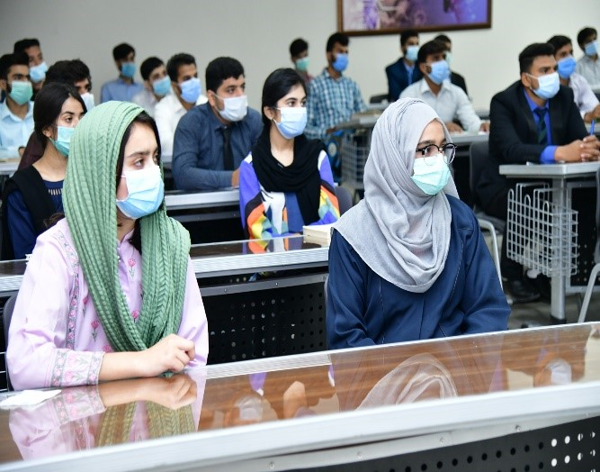
Smart Classrooms
Advanced educational environment which integrates technology to enhance the teaching and learning experience.
Advanced educational environment that integrates technology to enhance the teaching and learning experience.

Slide 20
Digital Signage
Versatility in providing real-time information, messages, emergency alerts and announcements
Promotes campus events, academic deadlines, and news updates
Keeps students informed about campus news
Interactive campus maps for navigation
Tailored information for students, staff, and visitors

Slide 21
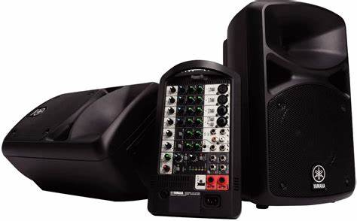
Public Addressing System
Facilitating communication during campus events, including academic conferences, workshops, and student gatherings.
Ensure clear communication between instructors and students in larger classrooms and lecture halls to a diverse audience

Slide 22

CCTV Cameras
Utilized to bolster campus security by monitoring key areas like entrances, parking lots, and common spaces, ensuring the safety of students, staff, and visitors
Help to deter unauthorized access and potential incidents.

Slide 23
THANK YOU!

